Slide 1

CSE230 Final Project
Splitwise-Haskell
Group39: Zhuo Zhi, Kaiqi Jin, Hao Feng, Ximin Chen

Slide 2
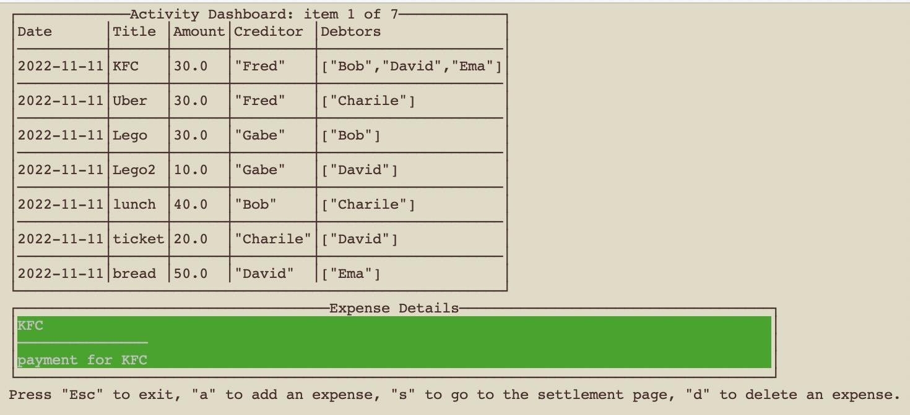

What is Splitwise?
Splitwise is used to simplify debts (a.k.a. “debt simplification”), which restructures debt within groups of people. It does not change the total amount that anyone owes, but it makes it easier to pay people back by minimizing the total number of payments.
Notes:
Splitwise tries to minimize the total number of transactions in the graph. As an example, consider this case. Alice, Bob, Carol, and Dave went on a trip together. Alice spent $60 and needs to get paid back by Bob, Carol, and Dave. Carol spent $20 and needs to get paid back by Bob and Dave. Dave spent $30 and needs to get paid back by Alice and Bob, and Alice’s share should be twice as big as Bob’s. Before: We can interpret these payments as a weighted directed graph, where people are vertices and edges are payments. After: We’ve simplified the graph down to a single payment. Pretty neat, right? You can see how a tool that does this automatically could be useful.

Slide 3
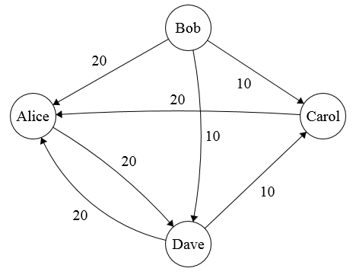
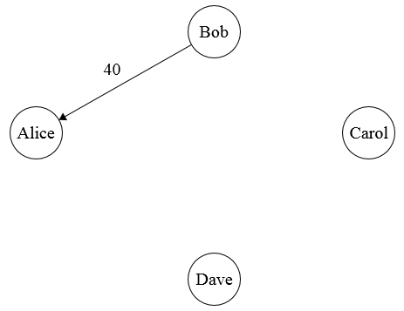
What is Splitwise?
Splitwise tries to minimize the total number of transactions in the graph.
Before: We can interpret these payments as a weighted directed graph, where people are vertices and edges are payments.
After: We’ve simplified the graph down to a single payment.
a lot of debt
pay off with just one transfer
Notes:
You can see how a tool that does this automatically could be useful. As an example, consider this case. Alice, Bob, Carol, and Dave went on a trip together. Alice spent $60 and needs to get paid back by Bob, Carol, and Dave. Carol spent $20 and needs to get paid back by Bob and Dave. Dave spent $30 and needs to get paid back by Alice and Bob, and Alice’s share should be twice as big as Bob’s.

Slide 4




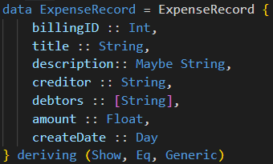
System Architecture
Algorithm
Finding minimal transactions
Provide Transaction Suggestions
User
Brick
Integrated to UI
User Input
Database
Provide Payment History
Query CRUD Operations
Notes:
We can simply divided our system architecture into 2 parts: frontend and backend. The frontend uses the Brick library for user interaction and UI displays. The backend contains the algorithm for finding the minimal number of transactions, and the database engine for payment history storage.

Slide 5
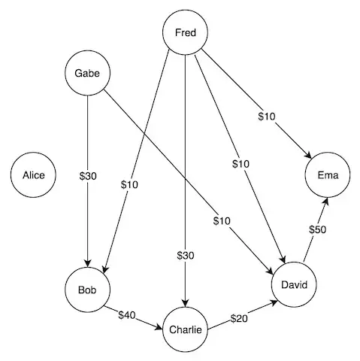
Interesting Observation
Name | pay | get | balance
Alice | 0 | 0 | 0
Bob | 40 | 40 | 0
Charlie | 20 | 70 | 50
David | 50 | 40 | -10
Ema | 0 | 60 | 60
Fred | 60 | 0 | -60
Gabe | 40 | 0 | -40
Name | balance
Charlie | 50
David | -10
Ema | 60
Fred | -60
Gabe | -40
Ema, Fred
Charlie, David, Gabe
Goal: find such subgroups
Notes:
Let’s take a look at the problem it self. This is the foundation of our application. Here are several interesting insights: #1: Who Owes Who Doesn't Matter! Who owes who doesn't matter! All that matters is that each person ends up not having any debts, and got all their lent money back, and they will be happy From here, it becomes the problem of how do you turn that final balance into all 0s with the minimum number of transactions. #2: Between n people you need at most n - 1 transactions to get everyone to 0 This means that with a single transaction you can always either make yourself to 0, or make that other person 0, depending on who had the bigger debt/credit amount. The last transaction will reduce both parties to 0, so overall you can always get everybody to 0 with n - 1 transactions. #3: Improve this by partitioning n people into subgroups that each sum to 0 any 0-sum subgroup you found will definitely be part of a valid partition, and can definitely be used to improve upon the original n - 1 answer.

Slide 6


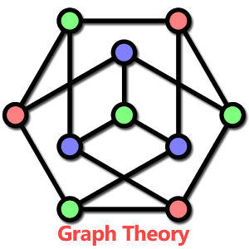
Choose Algorithm
Heuristic Algorithm (O(V)) In a greedy way, the person who owes the most money transfer as much as this person can to the largest creditor
Exact Algorithm (O(2^{V}V²)) Partition problme reduces to this problme, need to enumerate all possible zero-sum subgroups in the graph
Maximum-Flow Algorithm (O(V²E²)) Applicable when"no one owes a person that they didn't owe before", that is, no new edges can be introduced in the graph
Notes:
We could prove that Splitwise is NP-Complete, by showing Partition Problme reduces to Splitwise. Therefore, it is unlikely that there is a polynomial time algorithm to give an exact solution. The exact solution is a leetcode hard problem by the way. To minimize the number of edges, one natural idea is to send as much money as possible in every edge The heuristic algorithm is always close to the best solution. In practical, people also don't want to see the phone freeze. So this is the best algorithm.

Slide 7


Database
We use SQLite as our database engine, and use the library sqlite-simple for the implementation.
Why: The advantage of SQLite is that it is easier to install and use and the resulting database is a single file that can be written to a USB memory stick or emailed to a friend.

Slide 8
Highlights & Challenges
Practicability: The topic is practical, and the program is easy to use.
Interactive UI: User could view all the transactions, add or delete expenses, and look up the settlement table in one window.
Robustness: All the inputs will be validated.
Splitting algorithms: Researched and implemented several related algorithms.
Data persistence: Designed table schema, Data Access Object and integrated SQLite in Haskell.

Slide 9
Demo

Slide 10
Q&A
Thank you!
Reference: Verhoeff, T. (2004). Settling multiple debts efficiently: An invitation to computing science. Informatics in Education, 3(1), 105-126. K, M. M. (2020, January 4). Algorithm behind splitwise's debt simplification feature. Medium. Retrieved December 6, 2022, from https://medium.com/@mithunmk93/algorithm-behind-splitwises-debt-simplification-feature-8ac485e97688 The blogging gauntlet: May 10 - Splitwise is NP-complete. Sorta Insightful. (n.d.). Retrieved December 6, 2022, from https://www.alexirpan.com/2016/05/10/may-10.html Wikimedia Foundation. (2022, November 28). Partition problem. Wikipedia. Retrieved December 6, 2022, from https://en.wikipedia.org/wiki/Partition_problem

